Slide 1


Ray Liang
6/3/24

Slide 2

Outline
Executive Summary
Introduction
Methodology
Results
Conclusion
Appendix

Slide 3
Executive Summary
Summary of Methodologies
Predict success of Falcon 9 first stage landing through web scraping API
Understand factors contributing to successful landings through data transformation
Estimate Overall Cost of Launch
Implement Machine Learning Techniques
Summary of all Results
Develop Predictive model for likelihood of success
Exploratory Data Analysis and Predictive Analysis Results

Slide 4
Introduction
Project background and context
SpaceX lists its Falcon 9 rocket launches on its website with a price tag of $62 million, while competitors charge over $165 million per launch, largely due to SpaceX's ability to recover and reuse the first stage. Ascertaining whether the first stage will successfully land can help predict the total launch cost, which is valuable data for any rival firm considering a competitive bid against SpaceX.
Problems you want to find answers
Optimal methods for predicting first-stage landing success.
Where are the Ideal launch locations.

Slide 5

Section 1

Slide 6
Methodology
Executive Summary
Data collection methodology:
Through SpaceX API and Web-scraping Wikipedia
Perform data wrangling
One hot encoded data for landing zones
Perform exploratory data analysis (EDA) using visualization and SQL
Perform interactive visual analytics using Folium and Plotly Dash
Perform predictive analysis using classification models
Initially, we loaded the dataset and divided it into features (X) and targets (Y). Following this, we normalized the feature set (X) to prepare it for analysis. For the classification task, we applied various algorithms, and for each technique, we fine-tuned the parameters utilizing GridSearchCV to optimize model performance.

Slide 7
Data Collection
Describe how data sets were collected.
You need to present your data collection process use key phrases and flowcharts
Data was gathered through a GET request to the SpaceX API.
The response content was subsequently decoded into JSON format by invoking the .json() function, and then transformed into a pandas dataframe via .json_normalize().
We proceeded to cleanse the dataset, inspect for any missing values, and impute these gaps as required.
Additionally, we conducted web scraping of Falcon 9 launch records from Wikipedia using BeautifulSoup.
Our goal was to extract the launch records in the form of an HTML table, parse this table, and then transcribe it into a pandas dataframe to facilitate subsequent analysis.

Slide 8
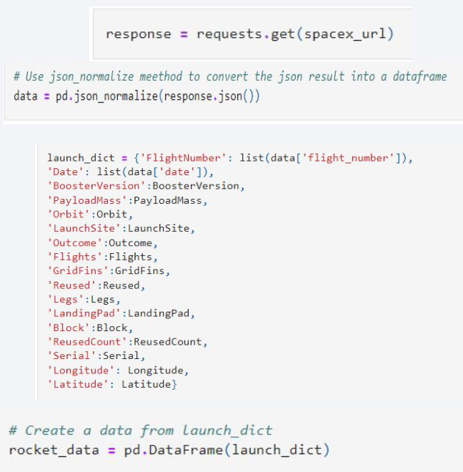
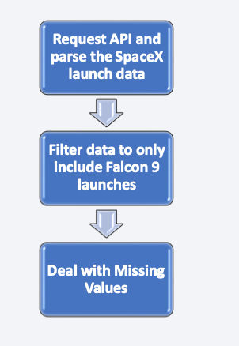
Data Collection – SpaceX API
Retrieve data from the SpaceX API and transform it into a Pandas dataframe.
Prepare the data by filtering and organizing it into a list.
Create an additional Pandas dataframe from the processed list data.
https://github.com/raysliang/Applied-Data-Science-Capstone/blob/main/01%20Data%20Collection%20API%20Lab.ipynb

Slide 9
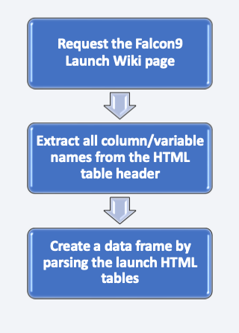
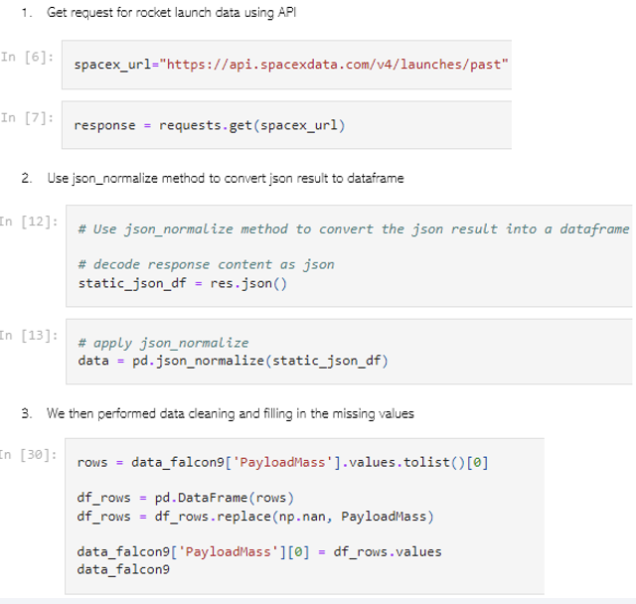
Data Collection - Scraping
Launch data for SpaceX can be sourced from Wikipedia as well.
Following a specific flowchart, data is acquired from Wikipedia and subsequently stored for use.
https://github.com/raysliang/Applied-Data-Science-Capstone/blob/main/02%20Complete%20the%20Data%20Collection%20with%20Web%20Scraping%20lab.ipynb

Slide 10
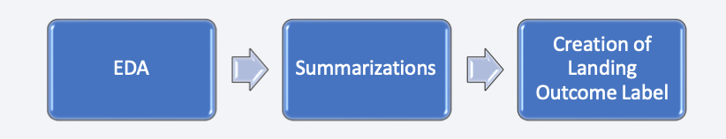

Data Wrangling
Conducted Exploratory Data Analysis (EDA).
Determined the total number of launch sites.
Computed the count and frequency of each orbit type.
Calculated the count and distribution of mission outcomes for each orbit type.
Generated a landing outcome label from the 'Outcome' column.
Exported the dataset to a CSV file.
https://github.com/raysliang/Applied-Data-Science-Capstone/blob/main/03%20Data%20Wrangling.ipynb

Slide 11
EDA with Data Visualization
Analyzed the correlation between Flight Number and Launch Site.
Examined the connection between Payload mass and chosen Launch Site.
Investigated the success rate associated with each orbit type.
Explored the relationship between Flight Number and Orbit type.
Studied the link between Payload mass and Orbit type.
Charted the trend of launch success over successive years.
https://github.com/raysliang/Applied-Data-Science-Capstone/blob/main/05%20EDA%20with%20Visualization%20Lab.ipynb

Slide 12
EDA with SQL
List unique space mission launch sites.
Identify top 5 'CCA' launch sites.
Calculate total payload by NASA CRS missions.
Average payload by Falcon 9 v1.1 boosters.
Date of first successful ground pad landing.
Boosters with successful drone ship landings carrying 4,000-6,000 kg payloads.
Count of successful vs. failed missions.
Booster versions with max payload.
2015 failed drone ship landings with booster versions and launch sites.
Rank landing outcomes from 2010-06-04 to 2017-03-20.
https://github.com/raysliang/Applied-Data-Science-Capstone/blob/main/04%20Complete%20the%20EDA%20with%20SQL.ipynb

Slide 13
Build an Interactive Map with Folium
Plotted all launch sites on a Folium map and added map features like markers, circles, and lines to indicate launch successes or failures at each site.
Categorized launch outcomes as 0 for failure and 1 for success.
Used color-coded marker clusters to visualize launch sites with higher success rates.
Measured distances from launch sites to nearby railways, highways, and coastlines, and analyzed their proximity to cities.
https://github.com/raysliang/Applied-Data-Science-Capstone/blob/main/06%20Interactive%20Visual%20Analytics%20with%20Folium%20lab.ipynb

Slide 14
Build a Dashboard with Plotly Dash
Created a dashboard using Plotly Dash.
Displayed Pie Charts to represent the count of successful launches across all sites.
Incorporated a slider to select a range of payload masses.
Generated a scatter plot that updates according to the selected payload range from the slider.
https://github.com/raysliang/Applied-Data-Science-Capstone/blob/main/07%20spacex_dash_app.py

Slide 15
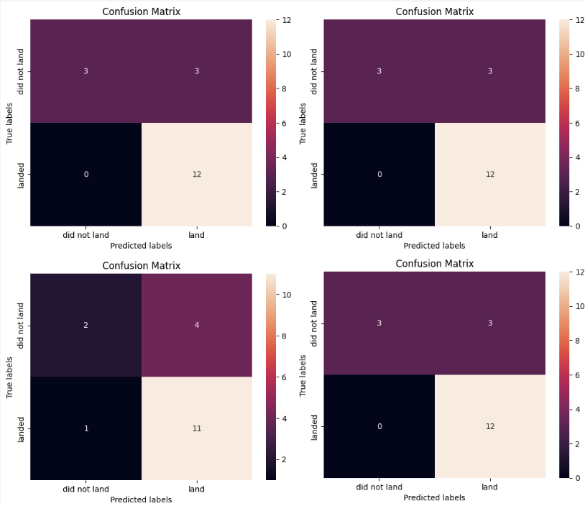
Predictive Analysis (Classification)
Conducted Exploratory Data Analysis (EDA) and identified training labels.
Added a column to denote the class.
Normalized the dataset.
Divided the dataset into training and testing subsets.
Searched for the optimal hyperparameters for SVM, Classification Trees, and Logistic Regression models.
Evaluated and compared the accuracy of each model using the test data.
https://github.com/raysliang/Applied-Data-Science-Capstone/blob/main/08%20Complete%20the%20Machine%20Learning%20Prediction%20lab.ipynb

Slide 16
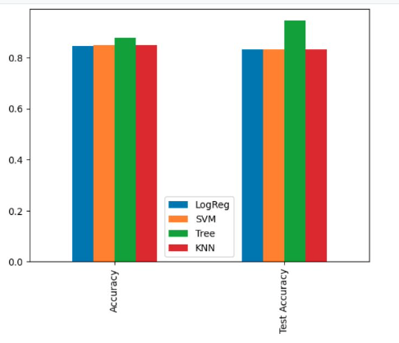
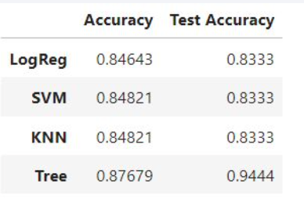
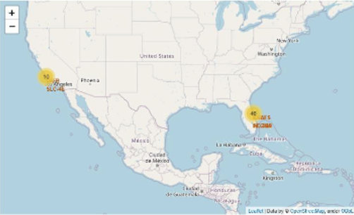
Results
SpaceX operates from four distinct launch sites.
Initial launches were conducted for SpaceX and NASA.
The F9 v1.1 booster's average payload is 2,928 kg.
The first successful landing occurred in 2015, five years after SpaceX's inaugural launch.
Numerous Falcon 9 boosters have successfully landed on drone ships, often carrying payloads above the average.
Mission outcomes have nearly a 100% success rate.
In 2015, two booster versions, F9 v1.1 B1012 and F9 v1.1 B1015, failed to land on drone ships.
Landing outcomes have improved over the years.

Slide 17

Section 2

Slide 18

Flight Number vs. Launch Site
The analysis of the plot indicates that a higher number of flights at a launch site correlates with an increased success rate at that site.

Slide 19
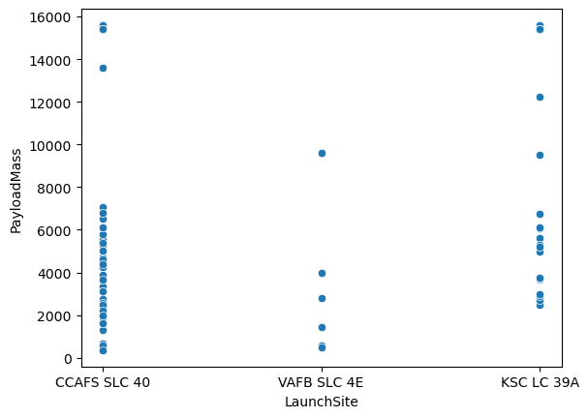
Payload vs. Launch Site
The CCAFS launch site has conducted the most launches, accommodating a wide range of payload masses.

Slide 20

Success Rate vs. Orbit Type
Show a bar chart for the success rate of each orbit type
Show the screenshot of the scatter plot with explanations
The highest SR orbits are ES-L1,SSO,and HEO

Slide 21

Flight Number vs. Orbit Type
Show a scatter point of Flight number vs. Orbit type
Show the screenshot of the scatter plot with explanations
The ISS is high in Success rate

Slide 22

Payload vs. Orbit Type
Show a scatter point of payload vs. orbit type
Show the screenshot of the scatter plot with explanations

Slide 23

Launch Success Yearly Trend
Show a line chart of yearly average success rate
Show the screenshot of the scatter plot with explanations
The success rate start to increase dramatically and the highest where in 2019

Slide 24

All Launch Site Names
Find the names of the unique launch sites
Present your query result with a short explanation here
We used Distinct command in sql to find the unique names in launch sites

Slide 25
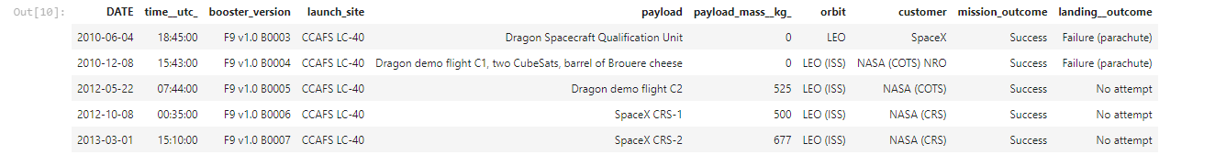
Launch Site Names Begin with 'CCA'
Find 5 records where launch sites begin with `CCA`
We used the following command (%sql select * from spacex where launch_site like '%CCA%' limit 5) and the result as follow

Slide 26

Total Payload Mass
Calculate the total payload carried by boosters from NASA
We used the command sum to calculate the total payload mass

Slide 27

Average Payload Mass by F9 v1.1
We calculated the average payload mass carried by booster version F9 v1.1 as 2928.4

Slide 28

First Successful Ground Landing Date
• Performed an SQL query to find the dates of the first successful landing outcome on ground pad

Slide 29

Successful Drone Ship Landing with Payload between 4000 and 6000
• Performed an SQL query to list the names of boosters which have successfully landed on drone ship and had payload mass greater than 4000 but less than 6000

Slide 30

Total Number of Successful and Failure Mission Outcomes
Performed an SQL query to calculate the total number of successful and failure mission outcomes

Slide 31

Boosters Carried Maximum Payload
Performed an SQL query to list the names of the booster which have carried the maximum payload mass

Slide 32

2015 Launch Records
• Performed an SQL query to list the failed landing outcomes in drone ship, their booster versions,
and launch site names for in year 2015

Slide 33

Rank Landing Outcomes Between 2010-06-04 and 2017-03-20
Performed an SQL query to rank the count of landing outcomes (such as Failure (drone ship) or Success (ground pad)) between the date 2010-06-04 and 2017-03-20, in descending order

Slide 34

Section 3

Slide 35
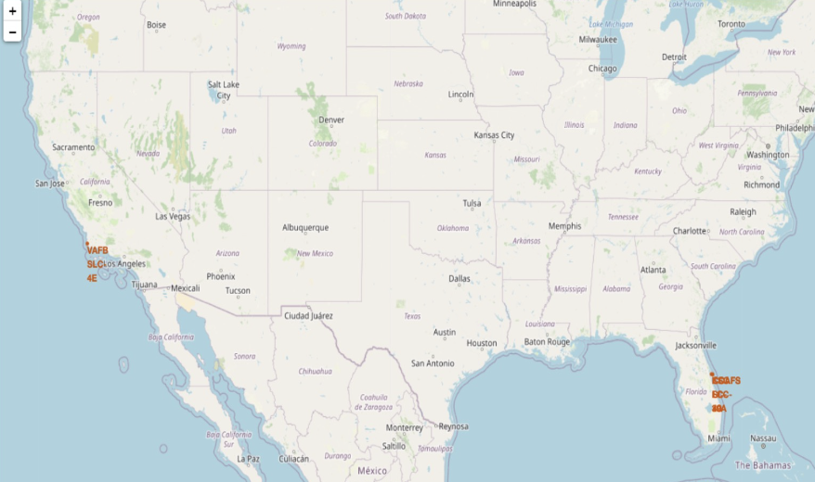
All Launch Sites on Map
• The launch sites are labelled by a marker with their names on the map.

Slide 36
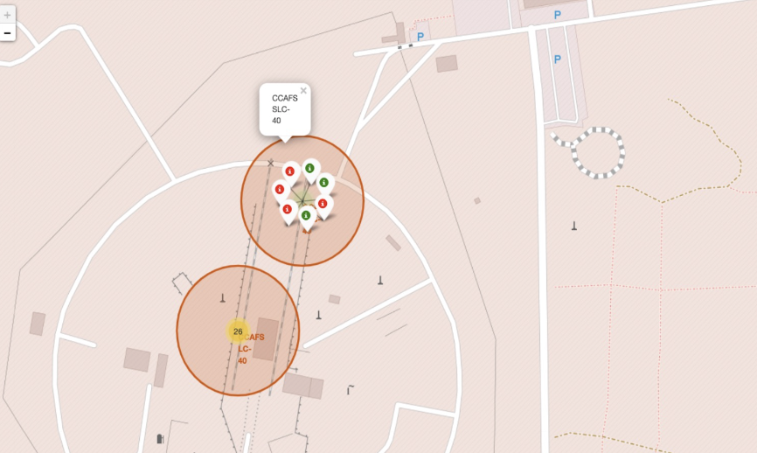
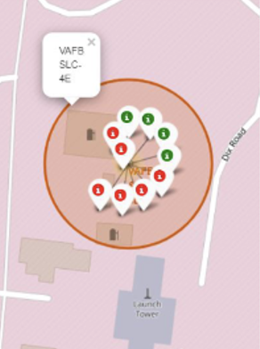
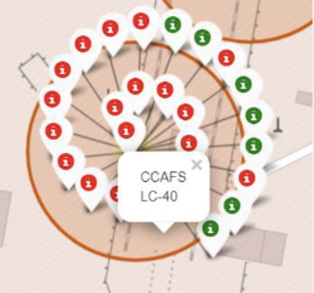
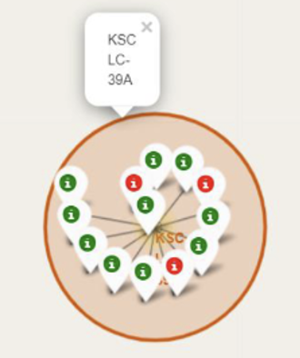
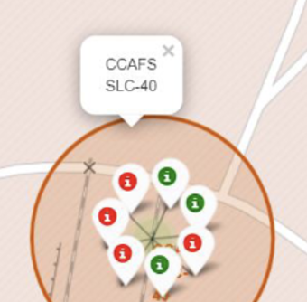
Markers showing Launch Sites
• The launch records are grouped in clusters on the map, then labelled by green markers for successful launches, and red markers for unsuccessful ones.

Slide 37
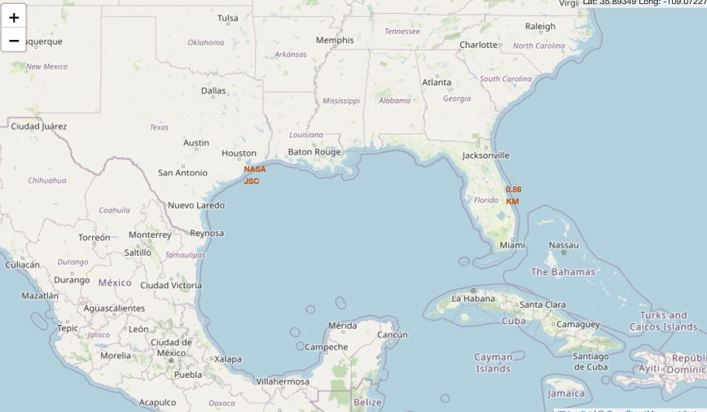
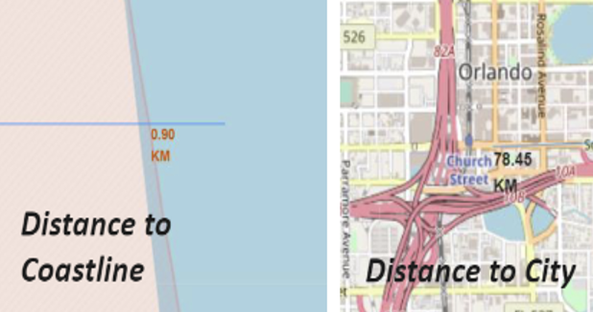
Distinace between Launch Sites Promixity
• The closest coastline from NASA JSC is marked as a point using MousePosition and the distance between the coastline point and the launch site, which is approximately 0.86 km.

Slide 38

Section 4

Slide 39
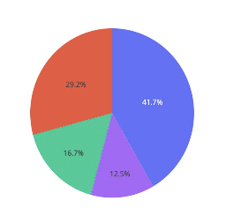
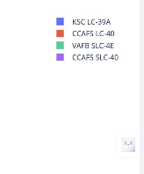
Total Success Launches
KSCLC39A has the highest amount of success launches with 41.7% from the entire record

Slide 40
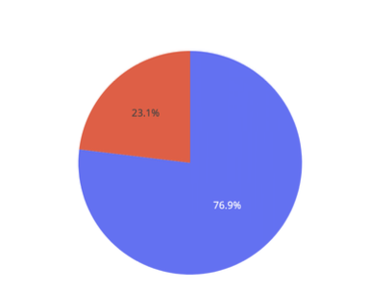
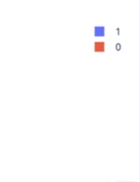
Successful Launch site Ratio
• KSCLC-39A achieved a 76.9% success rate and 23.1% failure rate

Slide 41
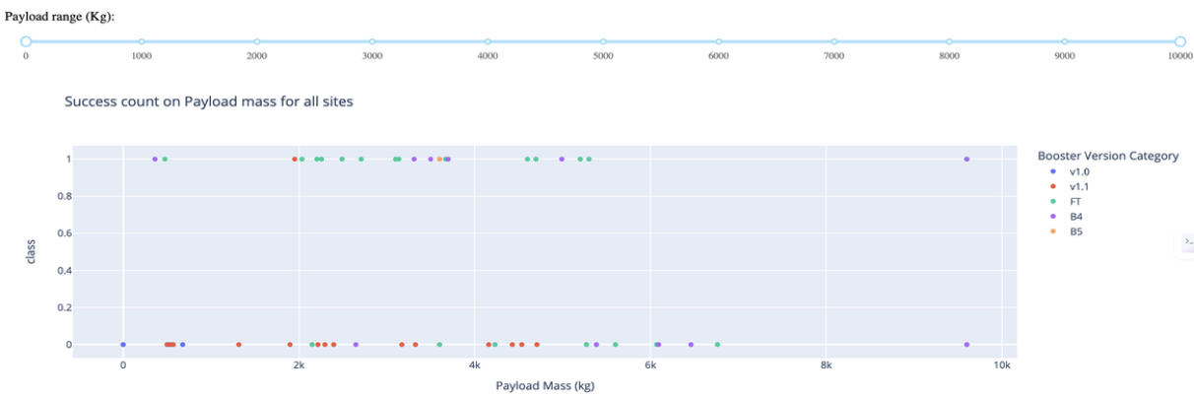
Payload vs Launch Outcome
Booster version FT (green spots) has the highest success launches, followed by B4 (purple spots) with the second highest success launches, among all booster versions.

Slide 42

Section 5

Slide 43
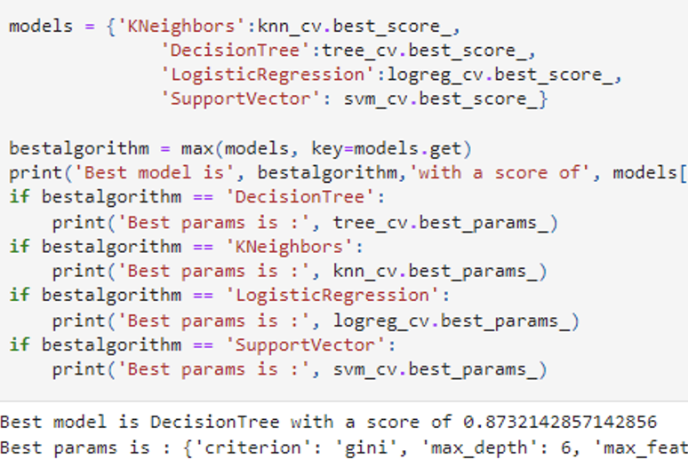
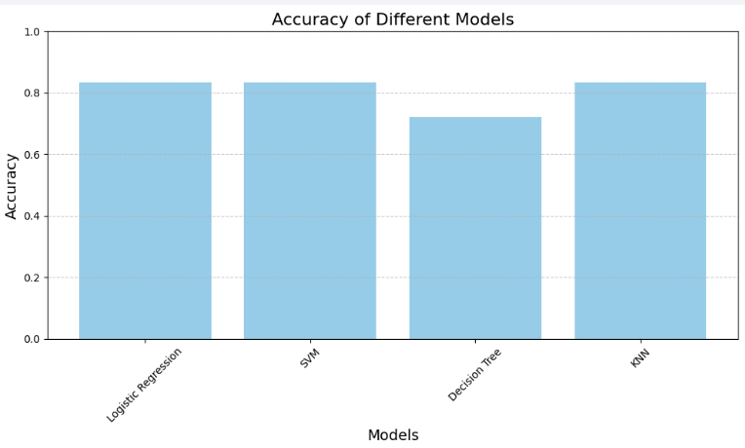
Classification Accuracy
The decision tree classifier is the model with the highest classification accuracy

Slide 44
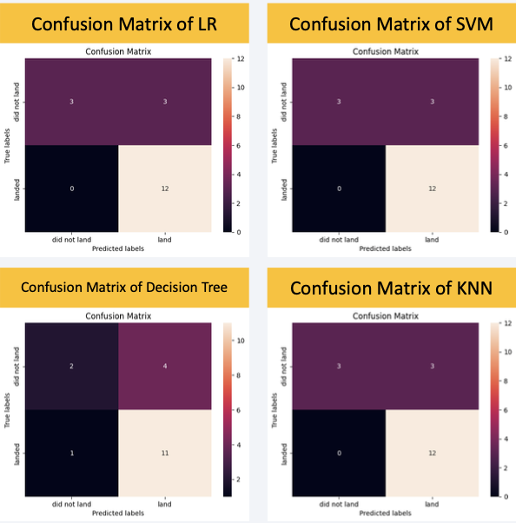
Confusion Matrix
LR (Logistic Regression), SVM (Support Vector Machine), and KNN (K-Nearest Neighbors) models accurately predicted all 12 successful landings with no errors.
The Decision Tree model correctly identified 11 successful landings but misclassified one as a failure or non-landing.
All three models, LR, SVM, and KNN, share the same accuracy rate of 83.33%, which is reflected in identical confusion matrices.

Slide 45
Conclusions
LR, SVM, and KNN are the best models for predicting this dataset's launch outcomes.
Smaller payloads are associated with higher success rates than larger ones.
SpaceX's launch success rate improves with experience, indicating a trend of increasing proficiency in launches.
Launch Complex 39A boasts the most successful launches relative to other sites.
GEO, HEO, SSO, and ES L1 orbits have the highest success frequencies.
KSC LC-39A has the most successful launches

Slide 46
Appendix
Include any relevant assets like Python code snippets, SQL queries, charts, Notebook outputs, or data sets that you may have created during this project
https://github.com/raysliang/Applied-Data-Science-Capstone

Slide 47


